Slide 1


The flaming resort nalsaroval
1

Slide 2
FLAMINGO YAYURVEDEC RESORT
“THE BEST AYURVEDIC CENTRE”

Slide 3
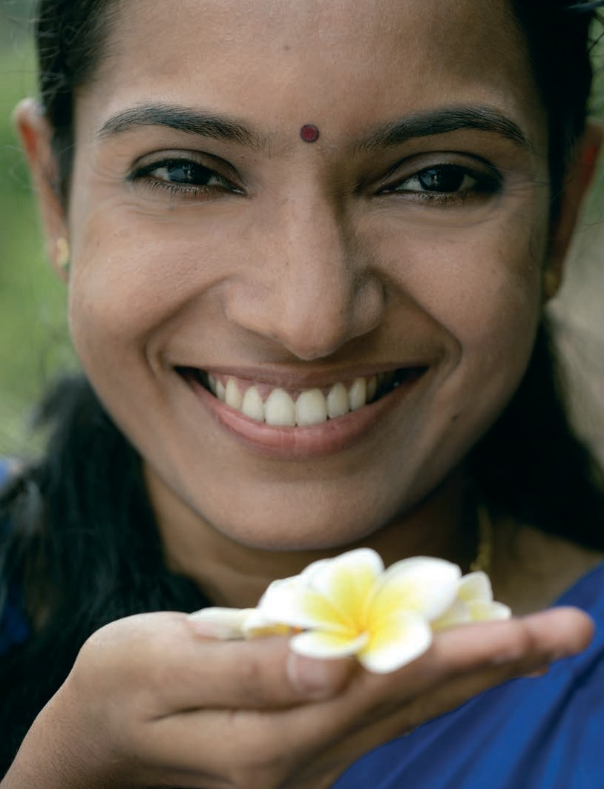


Slide 4


The ancient teachings of Ayurveda are undoubtedly among the most impor- tant ingredients of Indian culture.
They form the cornerstone of the flamingo , the first resort to have made Ayurvedic teachings well-known beyond India’s borders. Its aspiration was to provide Ayurveda, yoga and meditation in a peaceful and captivating setting.
Somatheeram is an Ayurvedic centre that adopted a holistic approach and at
the same time reﬂected India’s culture and beauty.
The flamingo is situated nrar to nal sarovar on the green lavish land
near Ahmedabad Indian state of Gujarat The location is just 60 minutes or 35 kilometres from Thistrionic city Ahmedabad ( Gujarat - national Airport. The resort itself is situated right by the near the beauty ful – far away from mass tourism, in the peaceful neighbourhood of the
Flamingo is close to the equator, so the climate is pleasant all year round. The months from June to October, the Monsoon period, is highly recommended for Ayurvedic treatments.
The months from October to February are regarded as the high season because of their temperate climate.
5

Slide 5

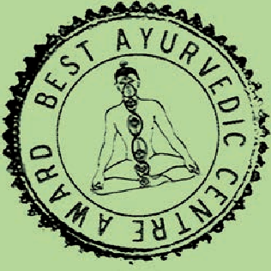
1. We live the Spirit of Ayurveda to enable you to find harmony
within yourself.
...
4. The German-Indian management is our secret of success to provide authentic Ayurveda at the highest possible level.
...
2. For approximately 30 years now the Somatheeram family has been growing continuously: Experience the feeling when your health is the centre of attention of our Ayurveda team.
...
5. You deserve to have someone who will take the time for you alone. Our highly qualified Ayurveda-Team guarantees to pay its full attention to your individual needs.
...
3. The highest award for Ayurveda Resorts certifies our ambition to provide the best Ayurveda in India. Somatheeram Ayurvedic Health Resort is the only Resort which has received the award continiously for „Best Ayurvedic Centre“ in the past years.
6. Ideal expert advice is the key to success for your treatments.
Our European Service Office takes care of all your questions and needs prior to your welcome by our team in Somatheeram.
Simply the best
Somatheeram is the undisputed No. 1 amongst all Ayurveda Resorts. So far it has been awarded ten times by the Department of Tourism as “The Best Ayurvedic Centre”.
With this government certified appreciation of its services and quality, it spearheads all other resorts, which offer Ayurvedic services.
Somatheeram also holds other seals of quality as the “Green Leave Certification” by the Government of Kerala.

Slide 6

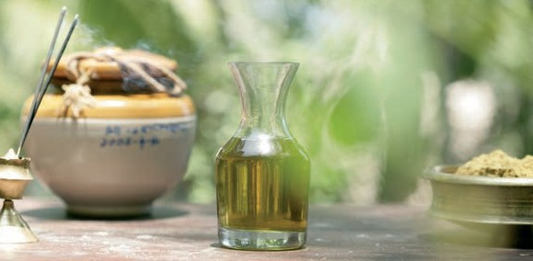

“A person is deemed healthy when their physiognomy is balanced, their digestion and metabolism are in good working order,
their tissue and excretory functions are normal and their soul, mind and senses are in a state of constant inner happiness.”
Sushruta, Ayurvedic doctor, 1000 BC
Ayurveda is a philosophy of life concerned with the preservation of a healthy life-style. It arose about 5,000 years ago in India and is considered the world’s oldest documented system of medicine. The earliest written records go back 3,000 years.
The term “Ayurveda” has its origin in Sanskrit. “Ayus” means life or life-span; “veda” means knowledge or also science. The composite term Ayurveda there- fore means not just “knowledge of life”, but embodies an aspiration to live one’s life in the best-possible state, physically and mentally. The Ayurvedic philosophy aims towards a long and above all healthy life in the sense of a balanced style of living – based on the three pillars of body, mind and soul.
The emphasis here is not only on the treatment of disease, but also on prevention
through purification and revitalisation.

Slide 7




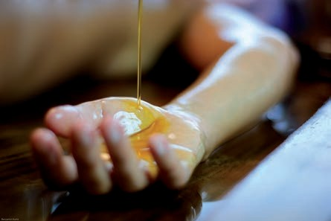

The person is seen as a unity of body, mind and soul – and any course of treatment
must therefore be geared to the patient’s individual needs. Any course of treatment therefore starts with an initial examination by the doctor in charge. This includes not only recording the case history and the current living ha- bits, but also a pulse diagnosis and a physical check-up. In this connection, deciding on the Dosha type according to the Ayurvedic Tridosha model plays a very important part.
Doshas exist in every person in his or her own personal mix from birth. They should always be in harmony with each other – even if their relative strengths can shift in the course of a lifetime.
The right balance of the Doshas is essential for physical and mental health. An unhealthy and unbalanced life-style or changes in the person’s circum- stances cause a shift in the natural balance. In Ayurvedic teachings this dis- turbance of the equilibrium is seen as the cause of disease.
The goal of any Panchakarma treatment is the restoration of this balance. The elementary features of any course of treatment are oil massages and various herbal and purification treatments as well as yoga and meditation. The precise treatment programme has to be drawn up individually for each guest. The same applies to the Ayurvedic diet plan. Depending on the Dosha constitution, the same spice or ingredient affects the balance of the Doshas in different ways.
Left: Our oils are manufactured in our own production – according to internati- onal GMP Standard
Right: Sirodhara – very suitable for treating insomnia or migraine

Slide 8


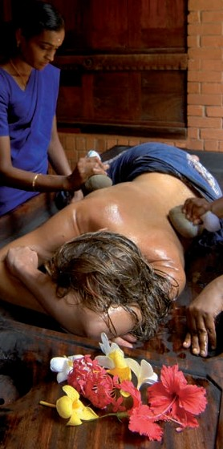
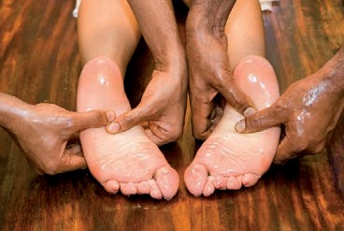
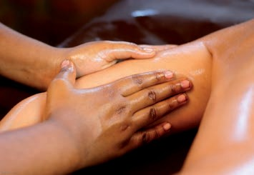
Based on our experience, we have put together various Panchakarma packages as selected treatment regimes.
The package price covers the cost of accommodation, treatment, yoga, meditation, Ayurvedic full board and other services such as transfer to and from the airport.
Should your state of health call for further treatment, the doctors will discuss this with you and notify you of the cost.
Please find details in our Tariff Booklet.
Treatments
Sirodhara, Sirovasthi or Kizhi may be known but Somatheeram offers over 30 different kinds
of Ayurvedic treatments. After your first consultation our doctors will decide which kind of single treat- ments are the most efficient for your constitution.

Slide 9
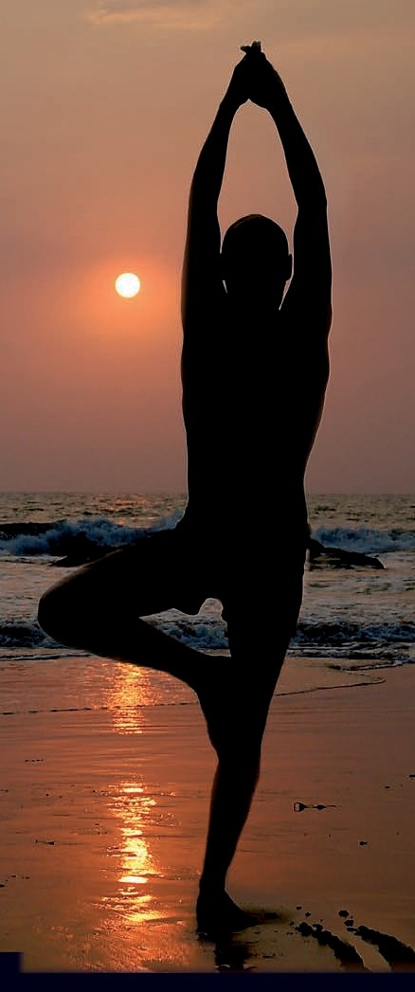

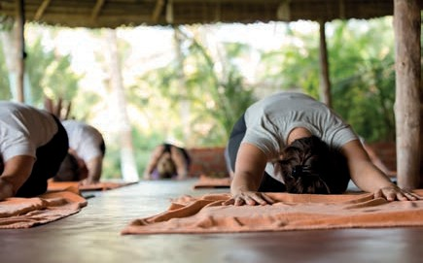
Yoga alleviates mental stress and encourages relaxation and inner peace. Furthermore, yoga can also be therapeutic – both as a remedy and as a pro- phylactic. In the Ayurvedic teachings, yoga and meditation are an essential part of any programme of treatment to establish a balance between the Doshas. In all but a few cases, yoga and meditation practice are integral parts of the daily schedule.
Whether you are a beginner or an advanced participant, the extensive experience of our yoga teachers is sure to deepen your knowledge and skills.
Flamingo I s offers different timings for beginner and advanced participant courses. Daily group courses are included in the different Ayurveda Packages. Single less- ons can be booked additionally.

Slide 10


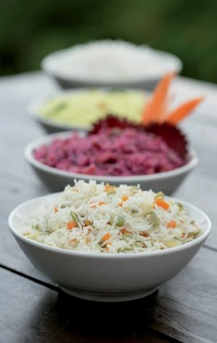
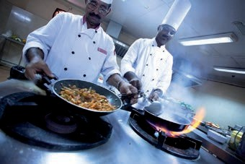
The right diet is a key to a healthy and fulfilled life – and all the more so during a stay in Somatheeram. If you want to improve your health, lose weight or purify the system, you should resort to Ayurvedic cuisine attuned to your particular constitution.
Integral to each course of Ayurvedic treatment is the appropriate diet. During the initial examination, the Somatheeram doctors compile a perso- nal Ayurvedic diet plan for each guest – in accordance with his/her personal Dosha or constitution. Various types of fruit, freshly pressed juices, exotic spices – all these promise a varied and tasty nutritional regime. Of course, the cuisine also includes non-Ayurvedic dishes from Europe and China.
A wide range of herbs are used for a balanced diet.
Ayurvedic Diet
An Ayurvedic meal thrives on the art of composition. The various ingredients are skilfully combined in terms of flavour, colour, consistency and preparation method.
The food has a pleasant aroma, stimulates the appetite and contains all six rasas or tastes in carefully measured quantities. An Ayurvedic meal is above all else balanced and in every respect wholesome. For it contains all the ingredients necessary for health: proteins, carbohydrates, fats, vitamins, minerals and trace elements. The preparation method and the combination of foods make the meal particularly agreeable and easy to digest. Roughly 200 different Ayurvedic dishes are available.
d
e
i
v
c
r
F
u
o
y
o
A
d
t
s
e
B
METRO
FOOD AWARD
2016
M
U
R
T
R
A
N
D
I
V

Slide 11

The building style is traditional Rajput Ana Indian, while the standard of furni- shings and hygiene is decidedly European. All the rooms are appointed with a shower, toilet, fans, mosquito nets, and telephone. Depending on the exact position of the accommodation, the nal sorovar is merely 1 to 10 minutes away.
12
12

